Slide 1

Introduction to Neural Networks
Part 1
github.com/gmarchet/dnnworkshop3

Slide 2
Pretensions to Thinking
“The Analytical Engine has no pretensions whatever to originate anything. It can do whatever we know how to order it to perform… Its province is to assist us in making available what we are already acquainted with.”

Slide 3
Still just pretending?
Google Duplex
What next?

Slide 4

Neural Networks

Slide 5
Perceptron
Perceptron: A weighted sum and a threshold function
weight1 ✖ input1
weight2 ✖ input2
weight3 ✖ input3
sum
Perceptron:
If sum > threshold: output 1
Else: output 0
✚
Example: The inputs can be your data. Question: Should I buy this car?
0.2 ✖ gas mileage
0.3 ✖ horsepower
0.5 ✖ num cup holders
sum
Perceptron:
If sum > threshold: buy
Else: walk
✚

Slide 6
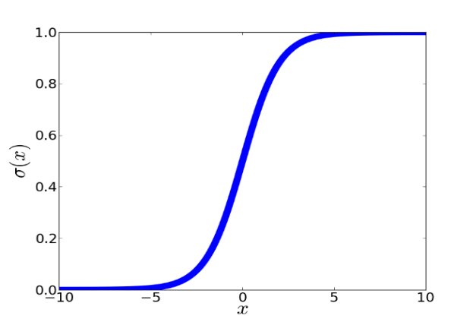
Perceptrons Are Chained Together
Deep learning comes from chaining these functions together
Chained together, they are called neurons
weight3 ✖ input3
weight1 ✖ input1
weight2 ✖ input2

Slide 7
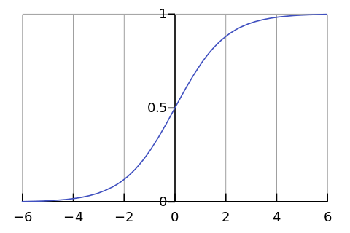
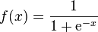
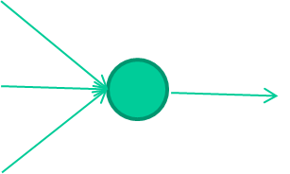
-0.06
W1
W2
f(x)
-2.5
W3
1.4

Slide 8
-0.06
2.7
-8.6
f(x)
-2.5
0.002
x = -0.06×2.7 + 2.5×8.6 + 1.4×0.002 = 21.34
1.4

Slide 9
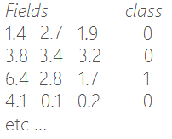
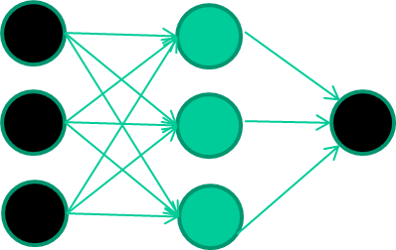
Example: Binary Classification

Slide 10
Training the neural network

Slide 11
Training the neural network
Initialise with random weights

Slide 12
Present a training pattern
1.4
2.7
1.9

Slide 13
Feed it through to get output
1.4
2.7 0.8
1.9

Slide 14
Compare with target output
1.4
2.7 0.8
0
1.9 error 0.8

Slide 15


Adjust weights based on error
1.4
2.7 0.8
0
1.9 error 0.8

Slide 16
And so on ….
6.4
2.8 0.9
1
1.7 error 0.1
Repeat this thousands, maybe millions of times – each time
taking a random training instance, and making slight
weight adjustments
Algorithms for weight adjustment are designed to make
changes that will reduce the error

Slide 17
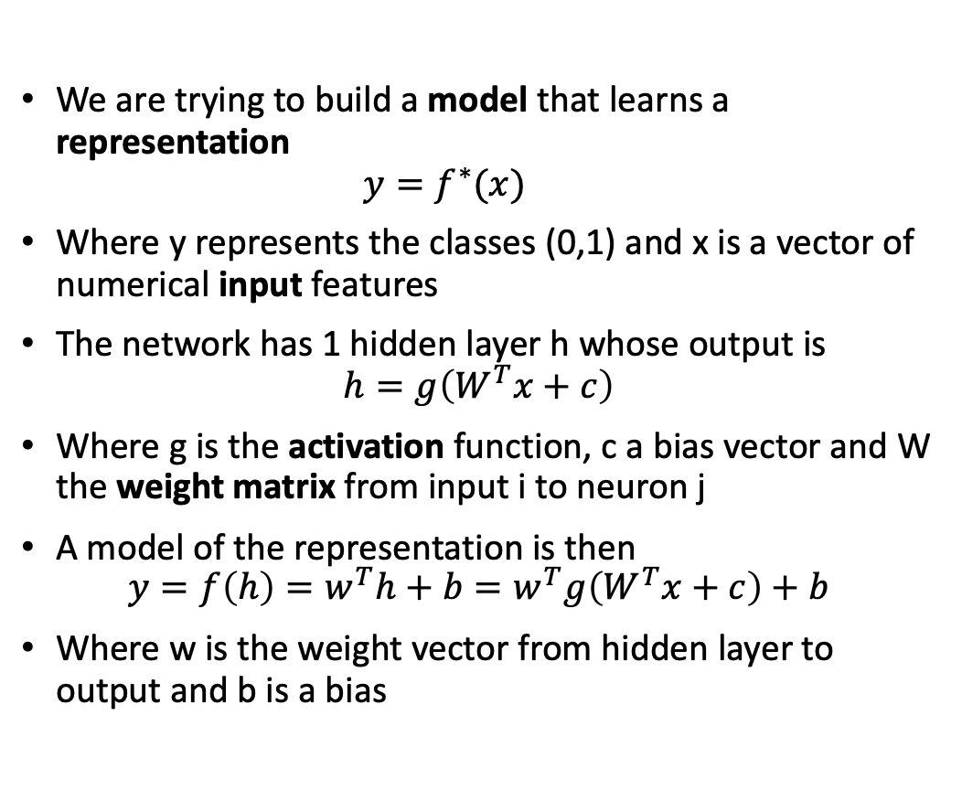
Representation
We are trying to build a model that learns a representation
$$y=f^{∗}(x)$$
Where y represents the classes (0,1) and x is a vector of numerical input features
The network has 1 hidden layer h whose output is
$$h=g\left(W^{T}x+c\right)$$
Where g is the activation function, c a bias vector and W the weight matrix from input i to neuron j
A model of the representation is then
$$y=f\left(h\right)=w^{T}h+b=w^{T}g\left(W^{T}x+c\right)+b$$
Where w is the weight vector from hidden layer to output and b is a bias
Notes:
As with most learning algorithms, we need a data set, a model, a loss or cost function and an optimization algorithm

Slide 18
Choice of Activation
Linear Units for gaussian output distributions
Sigmoid Units for Bernoulli output distributions
Used for binary classification, where we predict P(y=1|x)
Softmax Units for multi-Bernoulli output distributions
Used for multi-class classification, winner-take-all
Rectified Linear Units (ReLU) for hidden layers
Default choice, other possible but not often recommended

Slide 19
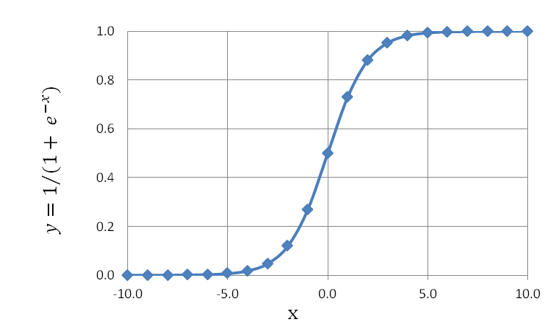
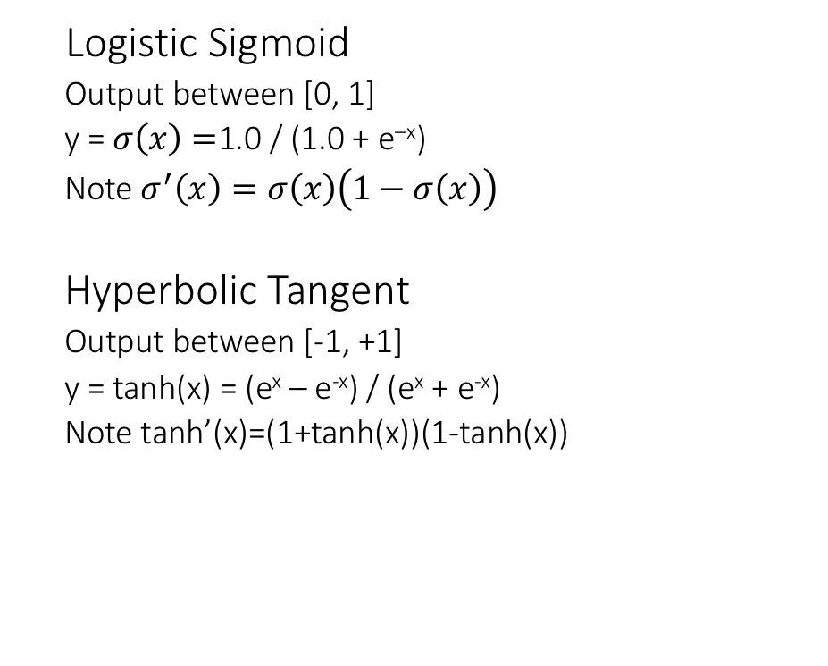
Common Activation Functions
Logistic Sigmoid
Output between [0, 1]
y = $σ\left(x\right)=$1.0 / (1.0 + e^{–x})
Note $σ^{′}\left(x\right)=σ\left(x\right)\left(1−σ\left(x\right)\right)$
Hyperbolic Tangent
Output between [-1, +1]
y = tanh(x) = (e^{x} – e^{-x}) / (e^{x} + e^{-x})
Note tanh’(x)=(1+tanh(x))(1-tanh(x))
Notes:
In reality for hidden nodes the choice is often more art than science. Logistic and tanh saturate, converge slowly and are more costly to differentiate and compute, hence ReLU

Slide 20
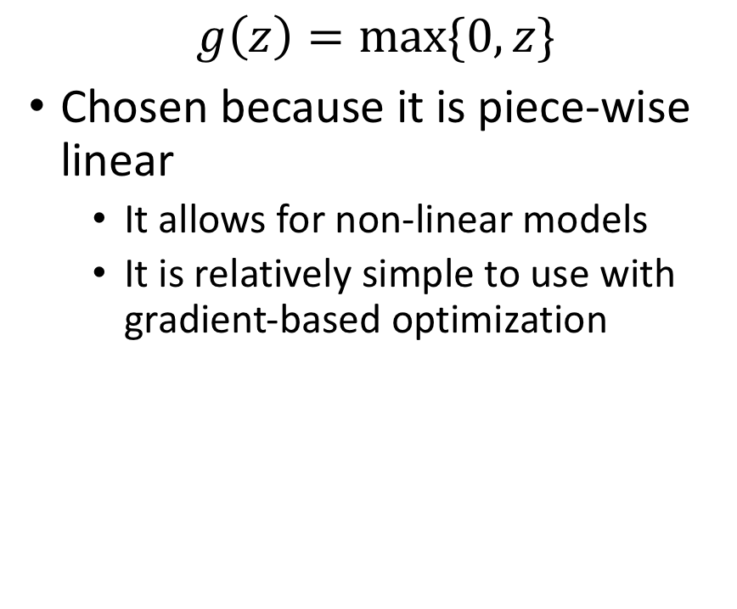
Rectified Linear Unit (ReLU)
$$g\left(z\right)=max⁡\{0,z\}$$
Chosen because it is piece-wise linear
It allows for non-linear models
It is relatively simple to use with gradient-based optimization

Slide 21
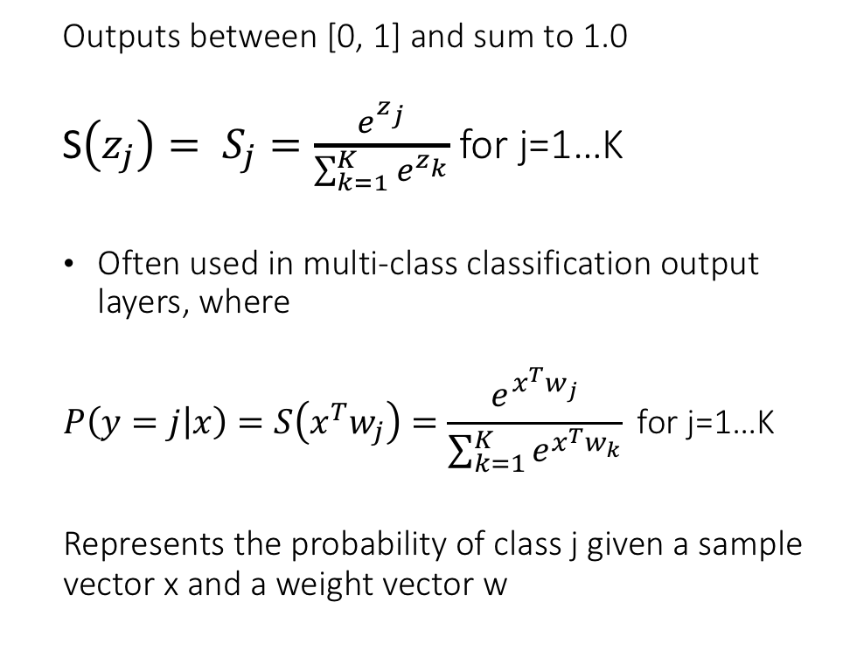
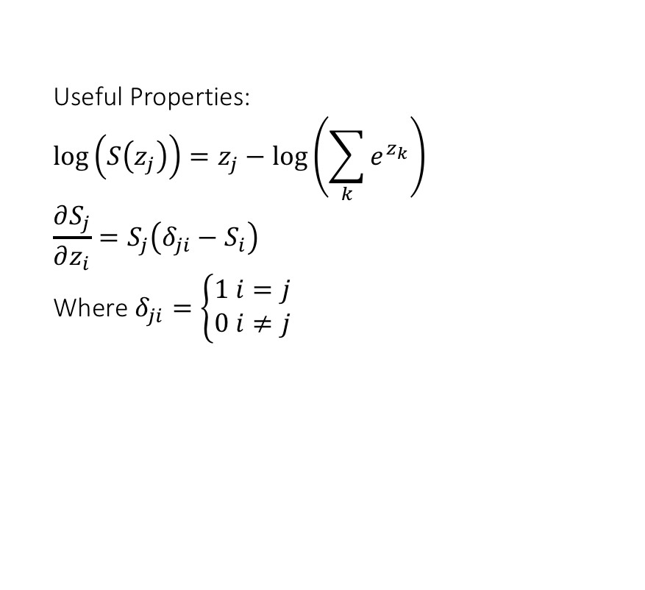
Softmax Activation Function
Outputs between [0, 1] and sum to 1.0
S$\left(z_{j}\right)= S_{j}=\frac{e^{z_{j}}}{\sum_{k=1}^{K}{e^{z_{k}}}}$ for j=1…K
Often used in multi-class classification output layers, where
$$P\left(y=j | x\right)=S\left(x^{T}w_{j}\right)=\frac{e^{x^{T}w_{j}}}{\sum_{k=1}^{K}{e^{x^{T}w_{k}}}} \text{for} \text{j}\text{=1…}\text{K}$$
Represents the probability of class j given a sample vector x and a weight vector w
Useful Properties:
$$\log\left(S\left(z_{j}\right)\right)=z_{j}−\log\left(\sum_{k}{e^{z_{k}}}\right)$$
$$\frac{∂S_{j}}{∂z_{i}}=S_{j}\left(δ_{ji}−S_{i}\right)$$
Where $δ_{ji}=\left\{\begin{matrix}1 i=j \\ 0 i≠j\end{matrix}\right.$

Slide 22
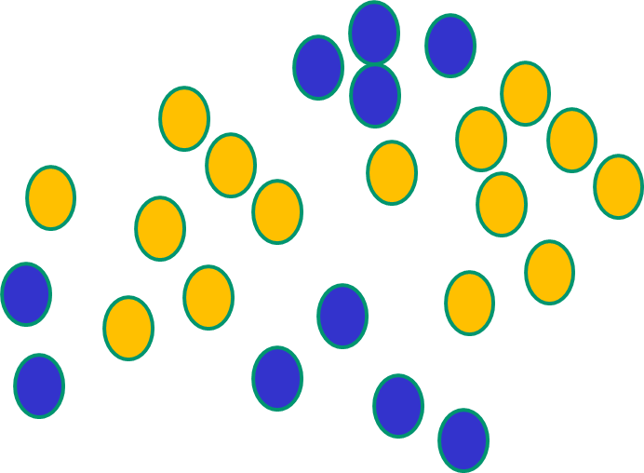
Non-Linearity
If f(x) is linear, the NN can only draw straight decision boundaries (even if there are many layers of units)

Slide 23
Non-Linearity
NNs use nonlinear f(x) so they
can draw complex boundaries,
but keep the data unchanged
Notes:
Other methods, such as SVMs project the data (linear transformation) then separate them with a linear decision boundary in the projected space

Slide 24
Learning
For a machine to learn a representation, it needs:
A data set
A model
A loss (or error or cost function)
An optimization method
It alters the parameters of the model to minimize its loss
It has been proven that NN thus constructed can in theory approximate any function, i.e. learn any representation

Slide 25
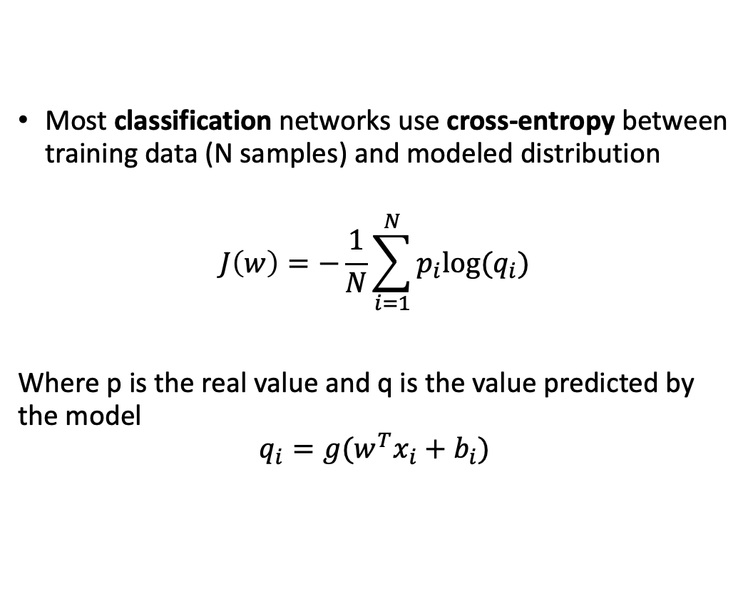
Cost
Most classification networks use cross-entropy between training data (N samples) and modeled distribution
$$J\left(w\right)=−\frac{1}{N}\sum_{i=1}^{N}{p_{i}{log⁡(q}_{i}})$$
Where p is the real value and q is the value predicted by the model
$$q_{i}={g(w}^{T}x_{i}+b_{i})$$
Notes:
Other commonly used loss functions are MAE (mean absolute error) and MSE (mean square error)

Slide 26
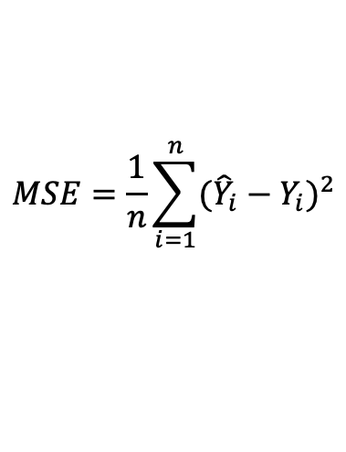
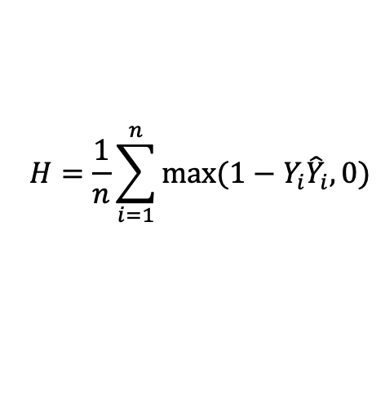
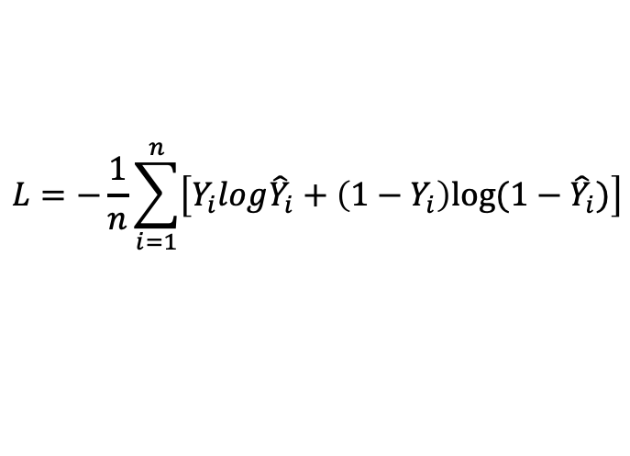
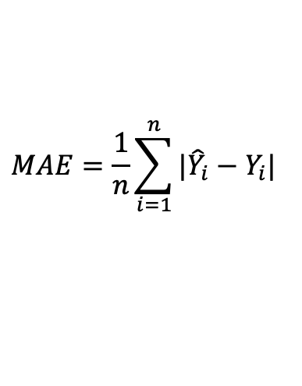
Common Cost Functions
For regression problems
$$MSE=\frac{1}{n}\sum_{i=1}^{n}{{({\hat{Y}}_{i}−Y_{i})}^{2}}$$
$$MAE=\frac{1}{n}\sum_{i=1}^{n}{{|{\hat{Y}}_{i}−Y_{i}|}^{}}$$
For classification problems
$$L=−\frac{1}{n}\sum_{i=1}^{n}{\left[Y_{i}log{\hat{Y}}_{i}+\left(1−Y_{i}\right)log⁡(1−{\hat{Y}}_{i})\right]}$$
$$H=\frac{1}{n}\sum_{i=1}^{n}{max⁡(1−Y_{i}{\hat{Y}}_{i}, 0)}$$
Notes:
In case of linear regression, mse is guaranteed to be convex – so a global minimum can be found
L is a variation of cross-entropy aka log-loss
Yhat is a prediction
For H or hinge loss it matters to have variables normalized in -1,1

Slide 27
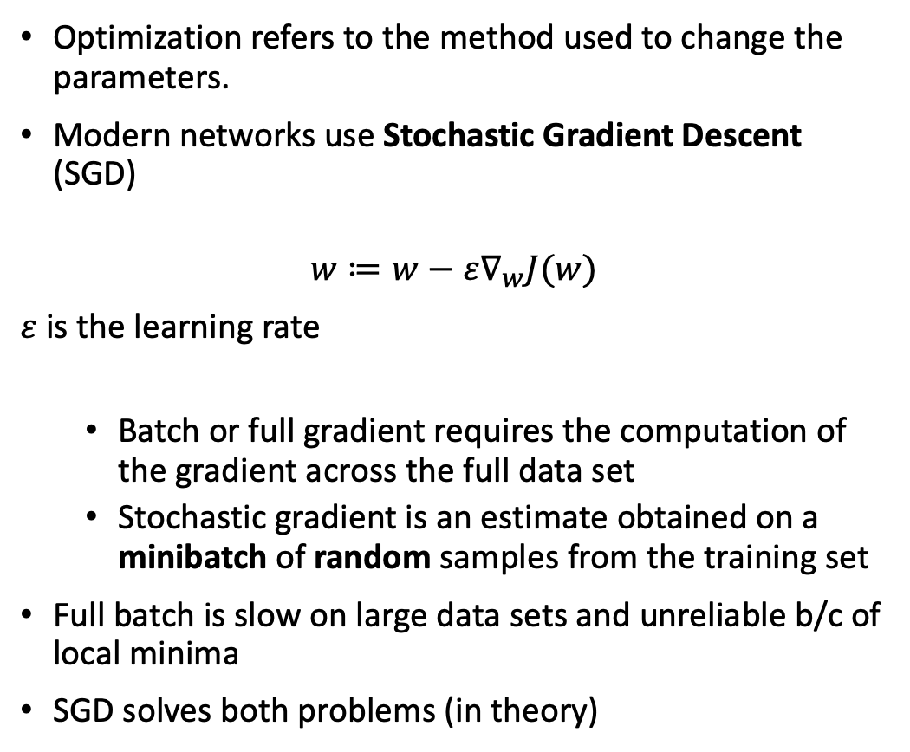
Optimization
Optimization refers to the method used to change the parameters.
Modern networks use Stochastic Gradient Descent (SGD)
$$w≔w−ε∇_{w}J(w)$$
$ε$is the learning rate
Batch or full gradient requires the computation of the gradient across the full data set
Stochastic gradient is an estimate obtained on a minibatch of random samples from the training set
Full batch is slow on large data sets and unreliable b/c of local minima
SGD solves both problems (in theory)
Notes:
Learning rate needs not be constant. It is generally small, but can be varied to optimize the algorithm

Slide 28
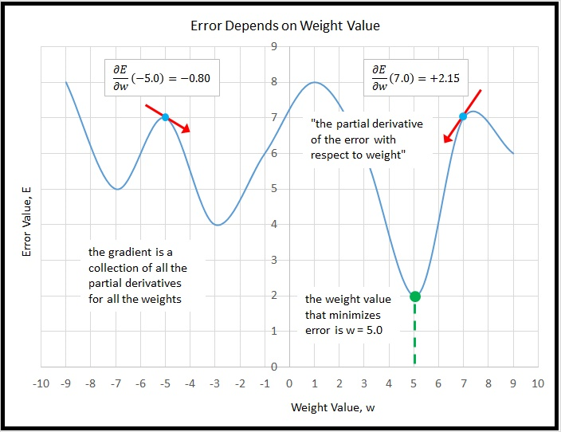

Slide 29
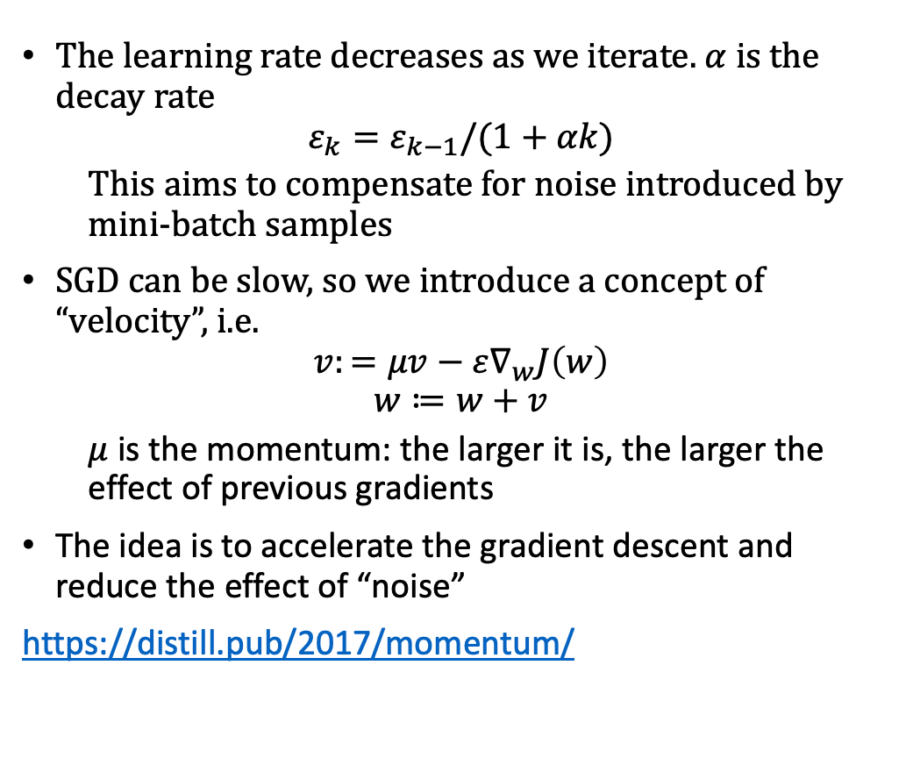
SGD in practice
The learning rate decreases as we iterate. $α$ is the decay rate
$$ε_{k}=ε_{k−1}/(1+αk)$$
This aims to compensate for noise introduced by mini-batch samples
SGD can be slow, so we introduce a concept of “velocity”, i.e.
$$v:=μv−ε∇_{w}J\left(w\right)$$
$$w≔w+v$$
$μ$ is the momentum: the larger it is, the larger the effect of previous gradients
The idea is to accelerate the gradient descent and reduce the effect of “noise”
https://distill.pub/2017/momentum/
Notes:
This is not the only learning decay equation. It is also common to decay linearly

Slide 30
SGD for Humans
Input learning rate, momentum, initial set of weights and biases, initial velocity
While stopping criterion (e.g. error value, n. of iterations) not met
Sample a minibatch from training set and relative targets
Predict the output (forward pass)
Compute the error
Compute gradient estimate (backward pass)
Compute the velocity (backward pass – cont.)
Update the parameters
End while

Slide 31
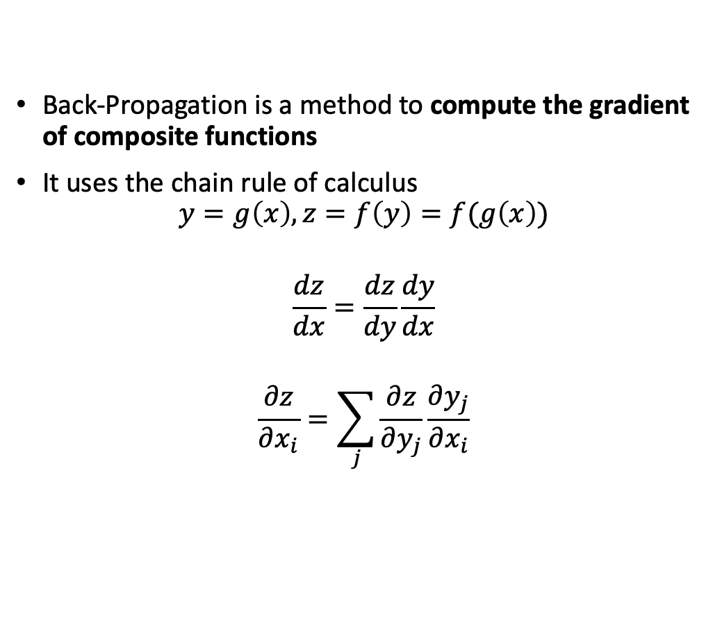
Back-Propagation
Back-Propagation is a method to compute the gradient of composite functions
It uses the chain rule of calculus
$$y=g\left(x\right), z=f\left(y\right)=f(g\left(x\right))$$
$$\frac{dz}{dx}=\frac{dz}{dy}\frac{dy}{dx}$$
$$\frac{∂z}{∂x_{i}}=\sum_{j}{\frac{∂z}{∂y_{j}}\frac{∂y_{j}}{∂x_{i}}}$$

Slide 32
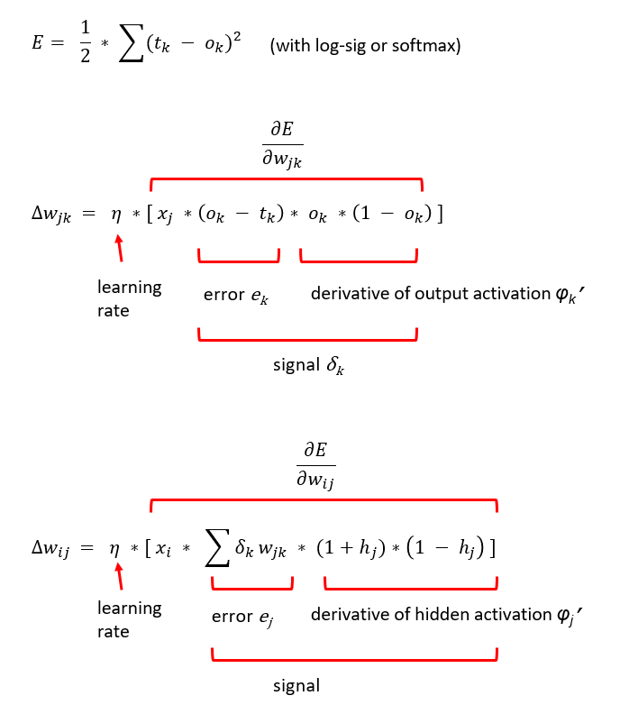
Example with MSE
Cost function is MSE
Activation of output is softmax
Activation of hidden layer is tanh
Output
Hidden

Slide 33
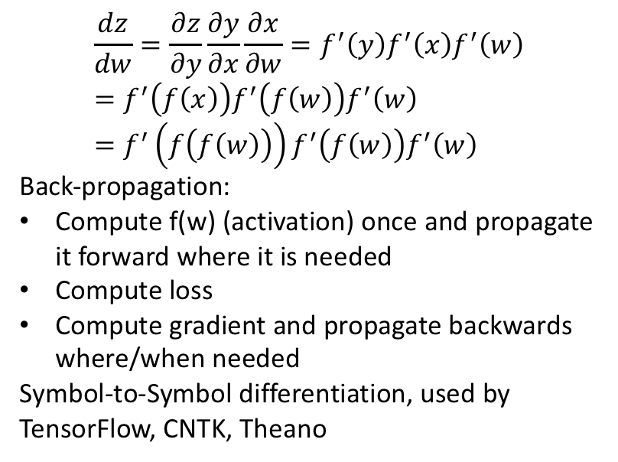
Propagation on a Graph
$$\frac{dz}{dw}=\frac{∂z}{∂y}\frac{∂y}{∂x}\frac{∂x}{∂w}=f^{′}\left(y\right)f^{′}\left(x\right)f^{′}\left(w\right)=f^{′}\left(f\left(x\right)\right)f^{′}\left(f\left(w\right)\right)f^{′}\left(w\right)=f^{′}\left(f\left(f\left(w\right)\right)\right)f^{′}\left(f\left(w\right)\right)f^{′}\left(w\right)$$
Back-propagation:
Compute f(w) (activation) once and propagate it forward where it is needed
Compute loss
Compute gradient and propagate backwards where/when needed
Symbol-to-Symbol differentiation, used by
TensorFlow, CNTK, Theano
From Goodfellow 2017

Slide 34
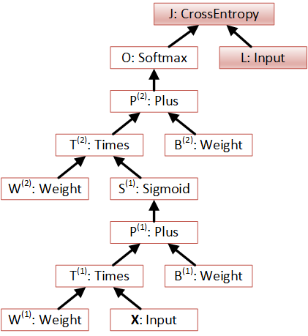
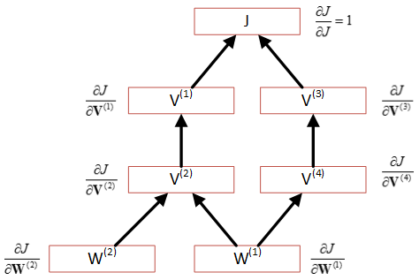
Computational Graphs
An example of efficient BP:
Each node keeps the value of V and the gradient of J wrt to V
A single-hidden-layer NN with x-entropy loss and softmax output

Slide 35
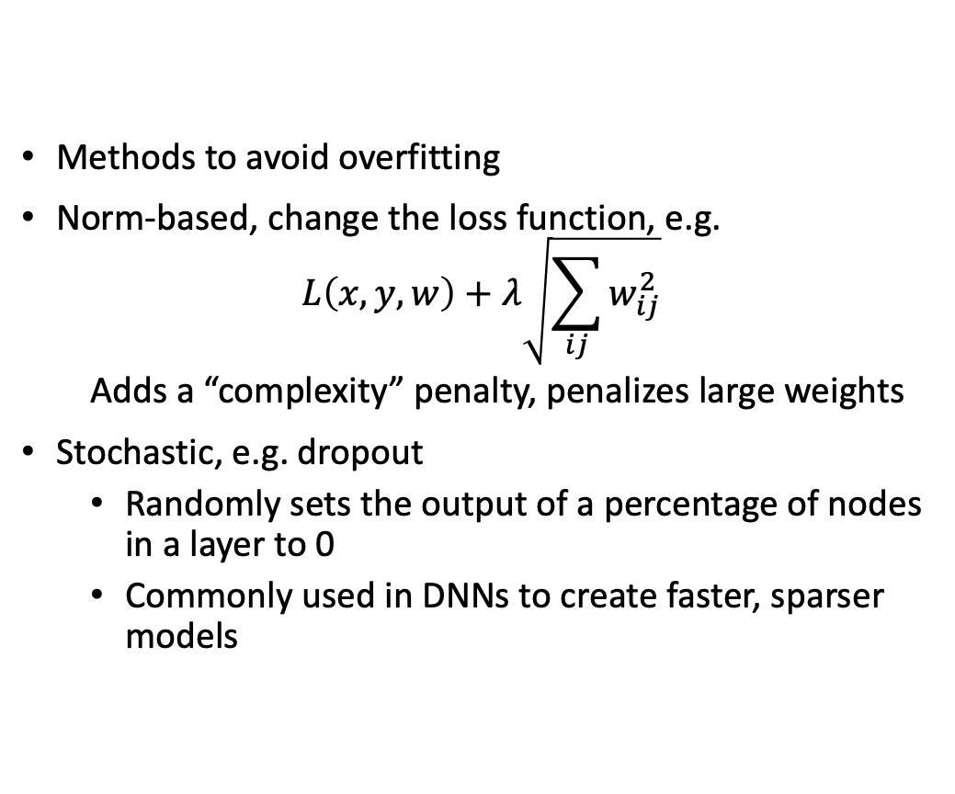
Regularization
Methods to avoid overfitting
Norm-based, change the loss function, e.g.
$$L\left(x,y,w\right)+λ\sqrt{\sum_{ij}{w_{ij}^{2}}}$$
Adds a “complexity” penalty, penalizes large weights
Stochastic, e.g. dropout
Randomly sets the output of a percentage of nodes in a layer to 0
Commonly used in DNNs to create faster, sparser models
Notes:
Frobenius or Euclidean or l2 norm for complexity
1-norm or taxi norm (sum of absolute values of vector) for parameter sparsity

Slide 36
Q&A
Now you know…
Lab 1 Time! Practice your keyboard skills!

